Slide 1
Fintech & Fraud Detection
CUNY LaGuardia Community College

Slide 2
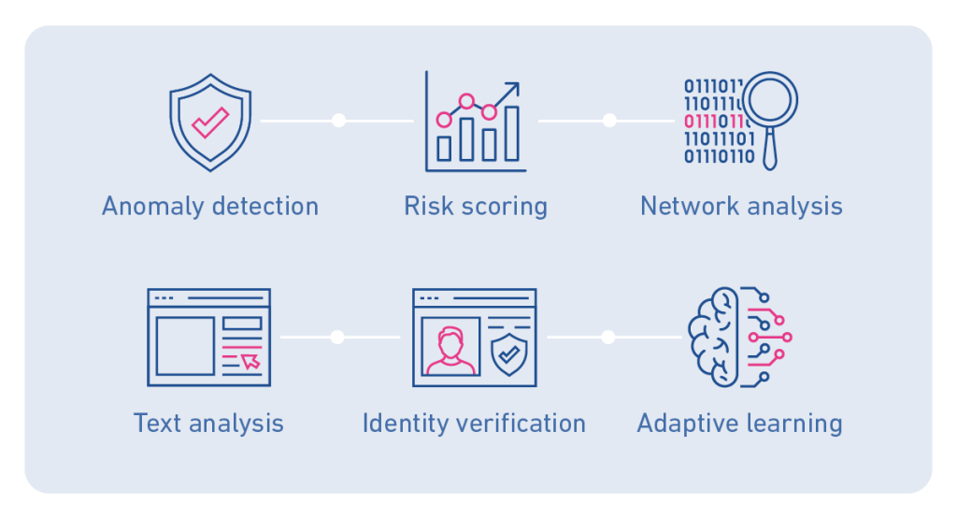
Types of Fraud Detection

Slide 3
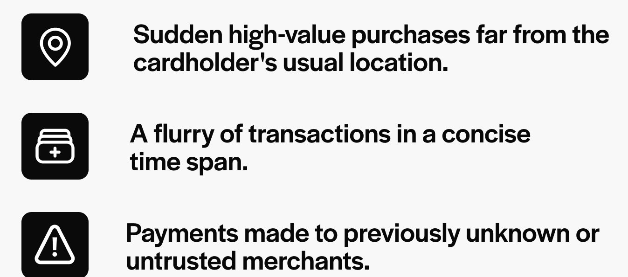
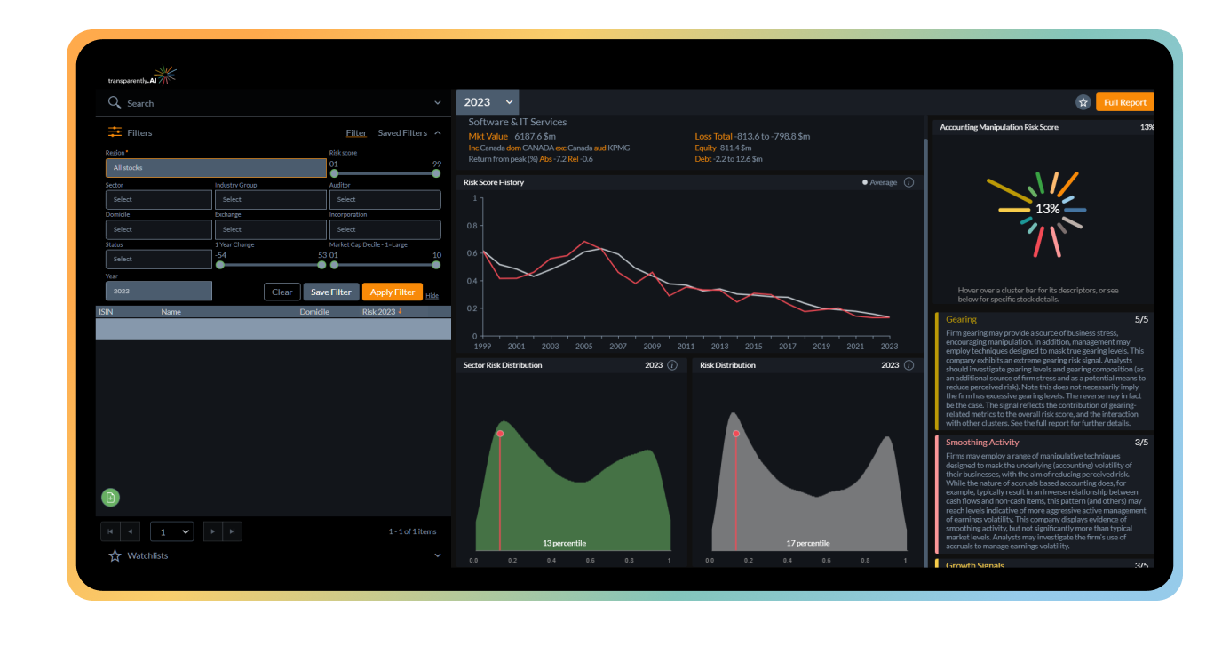
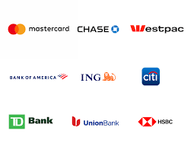



Anomaly Detection and Risk Scoring
Transactional Anomalies Investment Forecasting Anomalies

Slide 4
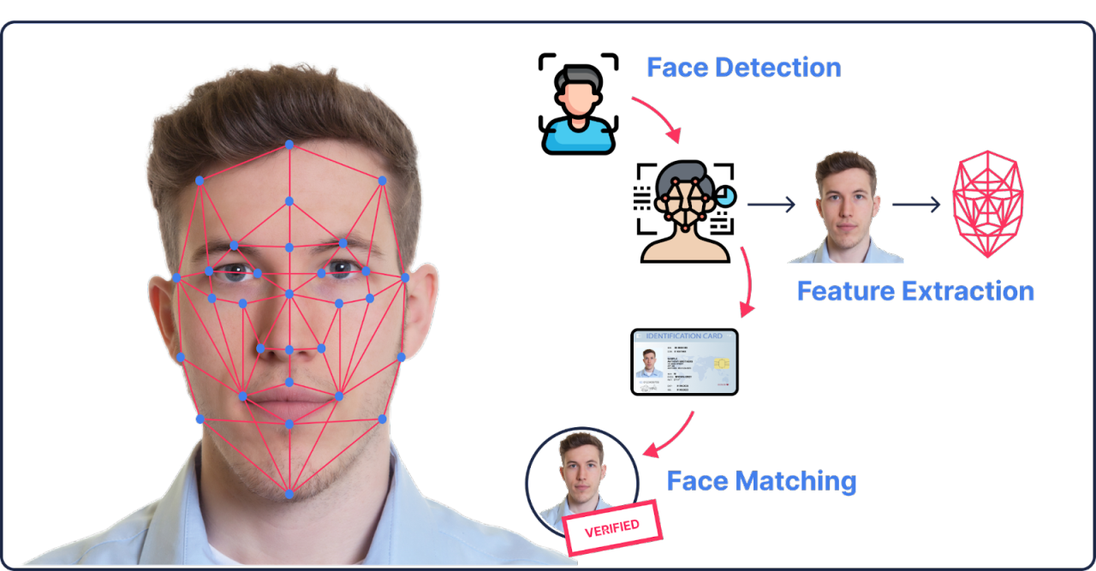
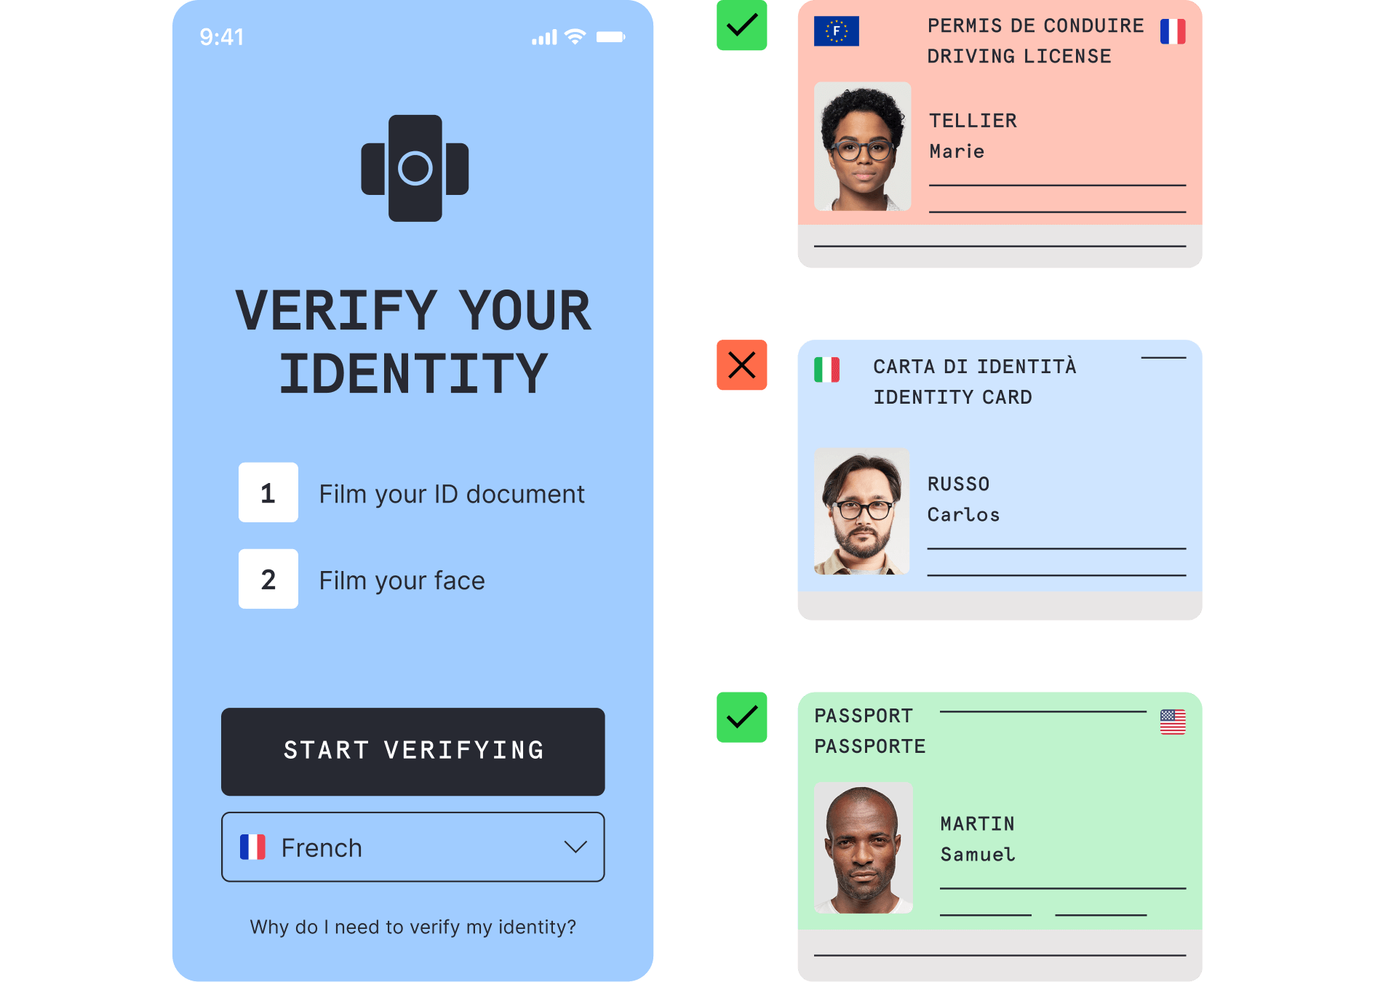
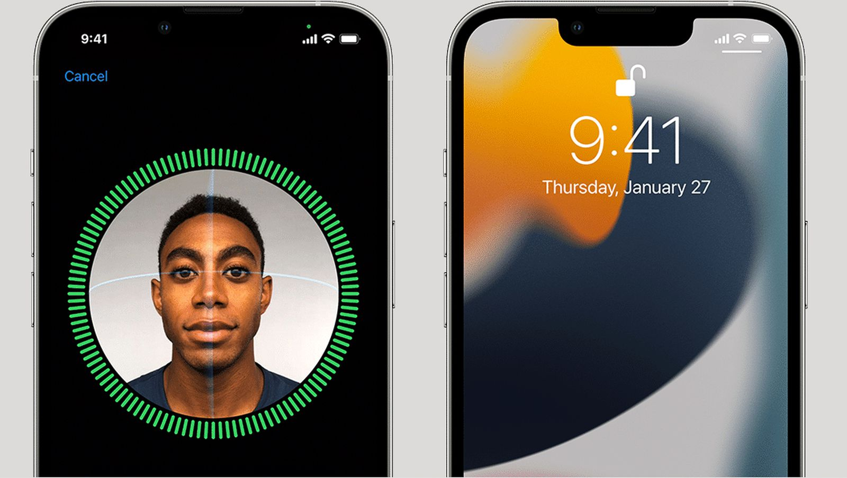
Identity Verification

Slide 5
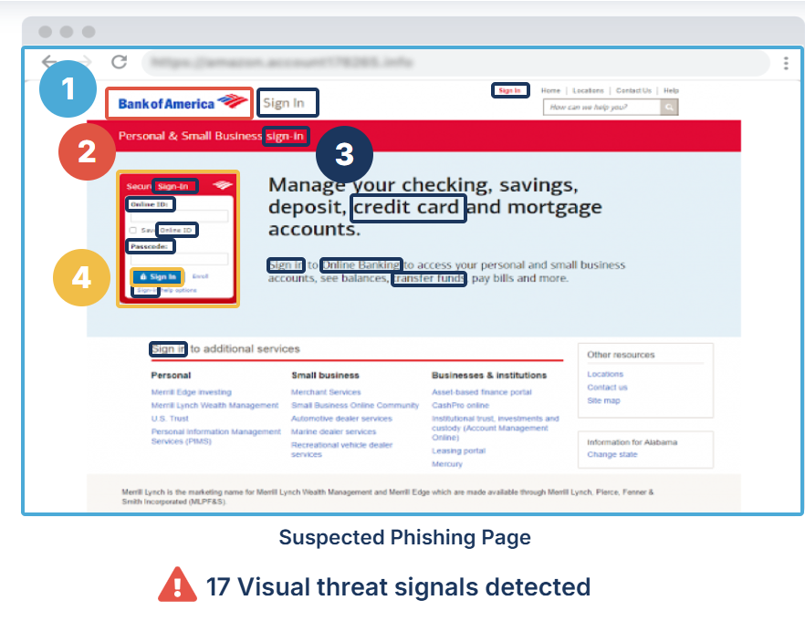
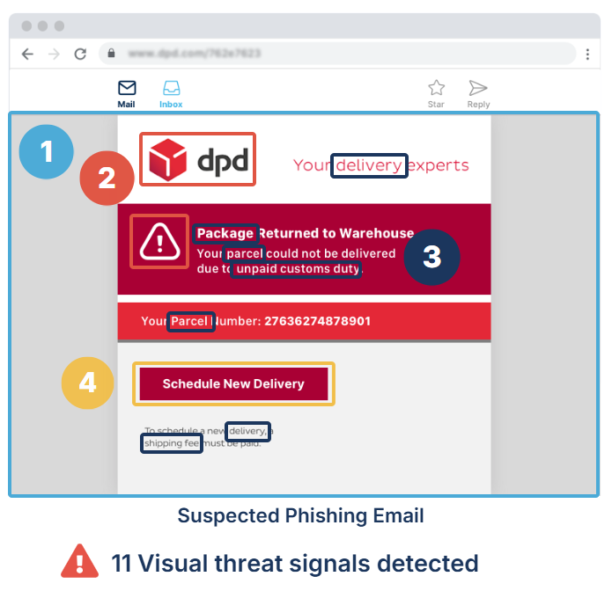
Text Analysis

Slide 6
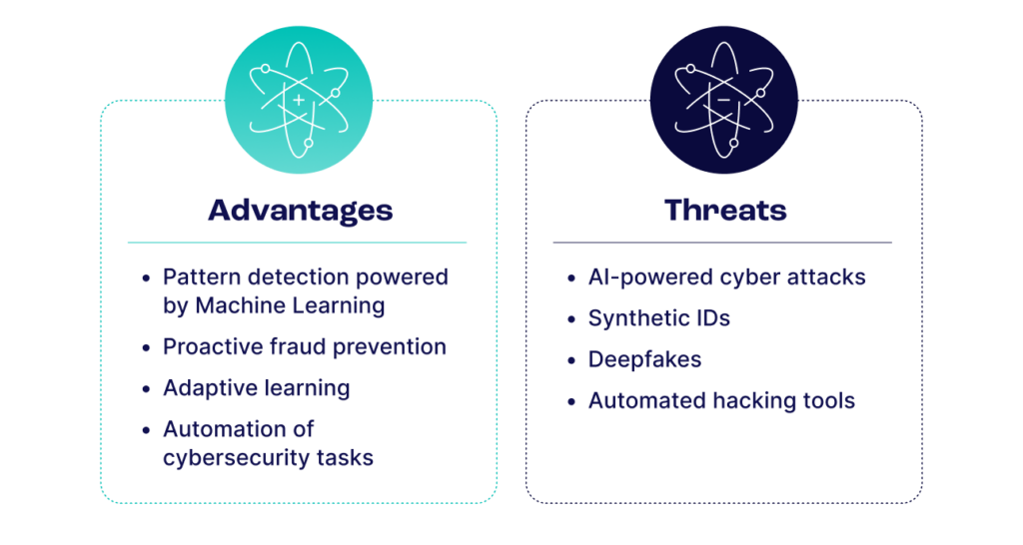
The Dual Impact of AI: Detection vs. Exploitation

Slide 7
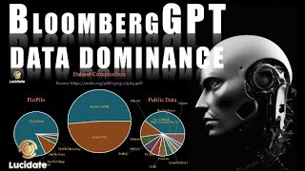
Case Study 1: BloombergGPT
Link to Word embeddings in Sixty Seconds: • Word Embeddings in 60 Seconds for NLP...
Link to in-depth video on word embeddings: • ChatGPT - Semantics: Transformers & N...
Link to Backpropagation explainer: • How neural networks learn - "Backprop...

Slide 8
Case Study 1: Discussion
Question: Bloomberg GPT was built using decades of domain-specific financial data rather than fine-tuning an existing general-purpose model. What are the advantages and potential challenges of training a domain-specific language model from scratch compared to fine-tuning a general AI model like ChatGPT?
Question: Bloomberg GPT is positioned to enhance tasks like sentiment analysis, named entity recognition, and question answering in finance. What are the most critical ways this AI model could transform decision-making and innovation in the financial industry?
Question: Bloomberg GPT could significantly enhance financial decision-making, but it may also create new challenges, such as reinforcing market biases or misinformation. How can firms ensure the ethical use of AI in finance?

Slide 9

Case Study 2: Fraud Detection

Slide 10
Case Study 2: Discussion
Question: Fraud detection has become more automated with AI and machine learning, but do you think there’s still a role for human intuition in preventing fraud? Would you feel safer knowing a human reviewed certain transactions, or do you trust machines more?
Question: Fraud detection systems rely on understanding your behavior to avoid false alerts, but this often means sharing more of your personal data, like spending habits or travel plans. How comfortable are you with sharing this kind of information with your bank or a company if it means fewer false fraud alerts? Where would you draw the line?
Question: The video highlights how both fraud prevention teams and fraudsters are using AI to outsmart each other. Do you think AI is currently doing more harm or more good in the battle against financial fraud? Why?

Slide 11
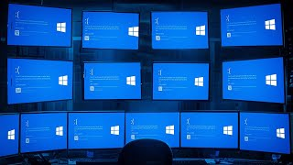
Case Study 3: How CrowdStrike Crashed the World

Slide 12
Case Study 3: Discussion
Question: The disaster revealed how interconnected and fragile our IT systems are. How does this make you feel about the reliance of critical infrastructure (e.g., healthcare, transportation, and banking) on technology? Do you think we’ve become too dependent?
Question: Who should bear responsibility for a disaster like this—the company that created the faulty update, the organizations that implemented the product without proper safeguards, or both? Why?
Question: The Crowdstrike update affected critical systems like hospitals and airlines. Should automation be treated differently in high-stakes environments, and if so, what additional safeguards should be mandatory?

